Slide 1
QUALITY ASSURANCE
Presented By
K. Gayathri Devi, M. Pharm.,
Assistant Professor,
Department Of Pharmaceutical Analysis,
MAM College Of Pharmacy,
Kesanupalli.

Slide 2
QUALITY ASSURANCE Is the process of verifying or determining whether the products or services meet or exceed the customer expectations.
SOURCES OF QUALITY VARIATION
RAW MATERIAL: Selection, processing and extraction, e.t.c
IN PROCESS VARIATION: During Mfg process, mixing, content uniformity, weighing, e.t.c
PACKAGING MATERIAL: Selection of packaging material with respect to product.
LABELLING: Errors during giving of labelling instructions, improper labelling.
FINISHED PRODUCT: Storage of finished product, dispatch, e.t.c
MANUAL ERROR: All the above may due to manual power.

Slide 3
CONTROL OF QV
RAW MATERIAL CONTROL: Two groups 1. Active/therapeutic
2. Inactive/inert
Selection of good raw material, maintain specifications in precise terminology.
Maintain details of test methods, instruments used and manner of sampling, e.t.c.
Sampling according SOP only, qualify control test, storage conditions and maintain batch no, lot no, material name, e.t.c.
The preserved sample should be retained for at least 7 years.
IN PROCESS ITEMS CONTROL:
Maintain FDP-CGMP guidelines to avoid contamination, errors, IPQA run to assess purity and quality uniformly.
Steps to be followed: 1. QA before start-up: Environmental and microbiological control and sanitation; raw materials and Mfg equipment.
2. QA at start-up: Raw material processing; compounding; packaging materials control; labels control; finished product control.
MFG VARIATION CONTROL: Monitoring environmental conditions under which products are Mfd or stored.
Monitoring of air and water systems to prevent contamination.
Air handling units.
Monitoring of personnel.
Feedback and follow-up.

Slide 4
STATISTICAL QC
Definition:
As an economic and effective system of maintaining and improving the quality of outputs through the whole operation process of specification, production and inspection based on continuous testing with random samples.
METHODS OF QUALITY CONTROL
Control Chart
Acceptance sampling techniques
1. Control Chart: A statistical chart used for controlling Mfg process, is a graphical method consists of three different lines. A. Central line B. Upper control limit C. Lower control limit
Functions:
To signal the presence of assignable causes of variation.
To give the evidence if a process is operating in a state of statistical control.
Control chart purpose: Show the data changes, show the causes of changes in data.
May be assignable changes or causes (Data outside control limits or trend in data), natural causes (Random variations around average).

Slide 5
TYPES OF CONTROL CHARTS: 1. Variable Charts
2. Attributes charts
Variable Charts: R&X – Chart
Attributes charts: P&C – Chart
R– Chart: Worn bearing, a loose tool, An erratic flow of lubricant to machine, Sloppiness of machine operator.
X– Chart: Due to tool wear, increase in temp..., different methods used in the second shift, new storage material.
P – Chart: Nominally scaled categorised data; good-bad.
C – Chart: Discrete quantitative data, shows no of non conformities in a unit.
ACCEPTANCE SAMPLING TECHNIQUES
To determine whether an incoming lot of a product meets specified standards.
Based on random sampling technique.

Slide 6
Advantages
More economical (fewer inspectors and less handling)
Upgrades the inspection
Applies to destructive stronger motivation for improvement.
Dis Advantages
Certain risk of not accepting conforming lots and accepting non conforming lots.
More time and effort is devoted to planning and documentation.
Less information is provided about the product. There is no assurance that the entire lot conforms to specification.

Slide 7
Good Laboratory Practices (GLP) for Pharmaceuticals and other Quality Control Laboratories
What is Good Laboratory Practice (GLP?)
Good Laboratory Practice contains a set of principles that provides a framework within which laboratory studies (Activities) are planned, performed, monitored, recorded, reported and archived. GLP help assure regulatory authorities that the data submitted are a true reflection of the results obtained during the study and can therefore be confidence upon when marking risk/safety assessment.
Why GLP is Important in Pharmaceuticals
Good Laboratory Practice contains different principles which are designed to ensure and promote consistency, quality, safety, reliability and integrity of chemicals during non-clinical and laboratory testing.

Slide 8
HISTORY
Good Laboratory Practices (GLP) was first introduced in New Zealand and Denmark in 1972, and later in the US in 1978. It was followed a few years later by the Organization for Economic Co-operation and Development (OECD) Principles of GLP in 1992 & the OECD has since helped promote GLP to many countries.
GLP is not only limited to chemicals but also it applies to medical devices, food additives, food packaging, colour additives and other non-pharmaceutical products or ingredients as well.

Slide 9
Basic Rules of GLP
Make sure to have the correct written instructions before starting a task.
Do not carry out task for which you have not been trained.
Keep records of information, results and actions taken. Make clear accurate records of what was done.
Check that the instrument/ equipment/material used are clean, calibrated and correct ones as per procedure.
Always notify if labels are seen either detached or appear to incorrect or are in wrong place.
Never remove a label which has been incorrectly applied and never stick a new label over an old one of the same type. If label is incorrectly affixed strike it off, sign and paste new correct label adjacent to it
Clean the glassware drying oven, refrigerator, walk in chamber incubators, water bath of the instruments like dissolution tester, disintegration testers etc, used in the quality control laboratories per the procedure.
Clean the work benches after completion of work or at the end of the day whichever is earlier and keep the respective specification, General test procedure (GTP), Standard test Procedure (SOP’s) etc used back to the designated place.
While closing the Quality Control Laboratory, ensure that all water taps, instruments (which are not running), equipments, computers are put ‘OFF’. Put off the lights, AC’s and closes the department.

Slide 10
Components of GLP
1.Premises and Utilities
2. Personnel
3. Training
4. Instruments/Equipments/Accessories
5. Validation/Verification of analytical methods
6. Testing and reporting
7. Stability studies
8. Chemicals, reagents, glassware and analytical standards
9. Documentation

Slide 11
Good Laboratory Practices (GLP) in terms of A to Z
A | Aprons/Analyst | N | Note books/Nose masks
B | Balances | O | Observations/OOS
C | Calibration/Chemicals | P | Procedures
D | Documentation | Q | Qualification
E | Entry & Exit | R | Reagents
F | Fume Hood | S | Safety/Solutions
G | Glassware | T | Training/Testing
H | Health/Hygiene | U | Upkeep
I | Instrument/Incidence | V | Validation
J | Justification | W | Weighing
K | Knowledge | X | X-ray diffraction
L | Logbooks/Laboratory | Y | Your Lab
M | Methods/Micro | Z | Zero Error

Slide 12
Results of Not following GLP in Laboratory
Accident/Incident & Health Hazards
Wrong/error in volume or weight measurement which may leads to wrong results.
May leads to Instrument errors/Malfunctions
Contamination of sample, reagent & solvent which may affect the product quality to be tested.
Waste of time due to investigation of unexpected cause.
Increase cost due to repetition & investigation
Due to wrong result it may affect patient safety.
Regulatory agency may take action results in warning letter, import alert etc.
No evidence or documented proof of data generated

Slide 13
Conclusion
Everyone makes mistakes that’s why GLP is needed. GLP principles are a good idea even if you are not required to follow the standards. There are some simple rules such as : Say What You Do (with written standard operating procedures), do what you say (follow the procedures), be able to prove it (with good record keeping).
The principles of good laboratory practice (GLP) is to support the development of quality and validity of test data used for determining the safety of chemicals and chemicals product.
Hence GLP aims to decrease the occurrence of mistakes or mix-ups through large and specific labelling requirements.
So every analyst those who are working in Quality control or in other testing laboratory should follow GLP.

Slide 14
VALIDATION
Definition :
Validation is the documented act of proving that any procedure, process, equipment, material, activity or system actually leads to the expected result.
ISO definition :
Validation is the confirmation by examination and the provision of objective evidence that the particular requirements for a specific intended use are fulfilled.
According to the Food and Drug Administration (FDA), the goal of validation is to: “establish documented evidence which provides a high degree of assurance that a specific process will consistently produce a product meeting its predetermined specifications and quality attributes.”

Slide 15
NEED OF VALIDATION
Before introduction of a new method into routine use.
Whenever the conditions change for which a method has been validated, e.g., instrument with different characteristics.
Whenever the method is changed, and the change is outside the original scope of the method.

Slide 16
Purpose of Validation
To accept an individual sample as a member of a population under study.
To admit samples to the measurement process.
To minimize later questions on sample authenticity.
To provide an opportunity for resampling when needed.

Slide 17
Advantages of validation
During the process the knowledge of process increases.
Assures the repeatability of the process.
Assures the fluency of production.
Assures that the product is continuously according to the marketing authorization.
Decreases the risk of the manufacturing problems.
Decreases the expenses caused by the failures in production.
Decreases the risks of failing in GMP.
Decreases the expenses of the every day production even though the validation itself will create expenses.

Slide 18
Scope of validation
Validation requires an appropriate and sufficient infrastructure including: -
organization, documentation, personnel and finances.
Involvement of management and quality assurance personnel.
Personnel with appropriate qualifications and experience.
Extensive preparation and planning before validation is performed.
A specific programmed for validation activities in place.

Slide 19
Validation done in a structured way according to documentation including procedures and protocols.
Validation should be performed:
for new premises, equipment, utilities and systems, and processes and procedures;
at periodic intervals; and
when major changes have been made.
Validation in accordance with written protocols.
A written report on the outcome to be produced.
Validation over a period of time, e.g.
at least three consecutive batches (full production scale) to demonstrate consistency. (Worst case situations should be considered.)
Demonstrate suitability for new manufacturing formula or method.
Process, materials and equipment to prove consistent yield of a product of the required quality.
Manufacturers to identify what validation work is needed.
Significant changes (facilities, equipment, processes) - should be validated
Risk assessment approach used to determine the scope and extent of validation needed.

Slide 20
MAJOR PHASES OF VALIDATION
1.PREVALIDATION QUALIFICATION ( PHASE 1)
2.PROCESS VALIDATION (PHASE 2)
3.VALIDATION MAINTAINANCE (PHASE 3)
PREVALIDATION QUALIFICATION PHASE
This includes all activities relating to product research and development , pilot batch studies, scale up studies, commercial scale batches, establishing stability conditions and storage and analysis of in process and finished dosage forms, equipment qualification, installation qualification, master production document, operational qualification and process capacity.

Slide 21
PROCESS VALIDATION PHASE
In this phase the limits of all critical process parameters are established, verified and validated to ensure that the desired quality of product can be achieved even under the worst condition.
VALIDATION MAINTAINANCE PHASE
This includes review of all documents related to process validation of audit reports, to make sure that no changes, deviations, standard operating procedures including change control procedures have been followed . Hence there is no need for requalification and revalidation.

Slide 22
PROTOCOLS OF VALIDATION
Protocols should specify the following in details.
The purpose and scope of study.
The purpose should already been clearly defined.
The process equipment system or subsystem should be clearly and precisely defined and details of performance characteristics is to be studied.
Installation and qualification requirement for new equipment should be done.
Where existing equipment requires up gradation with proper justification for the change(s) and statement of qualification requirement.
Stepwise details statement of action to be taken in performing the study.
Responsibility for performing the study to be assigned.
Statement on all test methodology to be employed with a precise statement of the test equipment or material to be used.
Calibration of test equipment is required.
References to any relevant standard operating procedures.
Requirement for the current format of the report on the study.
Acceptance criteria against which the success of the study is to be calculated.

Slide 23
Validation Master Plan (VMP)
A Validation Master Plan is a document that summarizes the firm's overall philosophy, intentions and approach to be used for establishing performance adequacy.
The Validation Master Plan could consist of:
Approval page and table of contents
Introduction and objectives
Facility and process description
Personnel, planning and scheduling
Responsibilities of committee members

Slide 24
Process control aspects
Equipment, apparatus, processes and systems to be validated
Acceptance criteria
Documentation
e.g. validation protocols and reports, SOPs, etc.
Training requirements

Slide 25
CONTENTS
A. Introduction to validation policy, scope, location and schedule.
B. Organizational structure with response to personnel and responsibilities.
C. Plant / process /production description mentioning rationale for inclusion or exclusion, extend of validation.
D. Specific process considerations that are critical & require extra attention.
E. List of products/processes/systems to be validated summarized in a matrix format , validation approach
F. Revalidation activities, actual status and future planning. G. Key acceptance criteria
H. Documentation format
I. Reference to required SOPs
J. Time plans of each validation project and sub project.

Slide 26
TYPES OF VALIDATION
The major types of Validation :
PROCESS VALIDATION
CLEANING VALIDATION
EQUIPMENT VALIDATION
VALIDATION OF ANALYTICAL METHODS
PROCESS VALIDATION
Definition
As per FDA Nov.2008,‘The collection of data from the process design stage throughout production, which establishes scientific evidence that a process is capable of consistently delivering quality products.
Types of Process validation:
Prospective validation.
Retrospective validation.
Concurrent validation.
Revalidation.

Slide 27
Prospective validation
carried out during the development stage by means of a risk analysis of the production process, which is broken down into individual steps.
These are then evaluated on the basis of past experience to determine whether they might lead to critical situations.
Where possible critical situations are identified, the risk is evaluated, the potential causes are investigated and assessed for probability and extent, the trial plans are drawn up, and the priorities set.
Concurrent validation
carried out during normal production
This method is effective only if the development stage has resulted in a proper understanding of the fundamentals of the process.
The first three production-scale batches must be monitored as comprehensively as possible.
The nature and specifications of subsequent in-process and final tests are based on the evaluation of the results of such monitoring.
his careful monitoring of the first three production batches is sometimes regarded as prospective validation.
Concurrent validation together with a trend analysis including stability should be carried out to an appropriate extent throughout the life of the product.

Slide 28
Retrospective Validation
Retrospective validation involves the examination of past experience of production on the assumption that composition, procedures, and equipment remain unchanged
such experience and the results of in-process and final control tests are then evaluated.
Recorded difficulties and failures in production are analyzed to determine the limits of process parameters.
Revalidation
Revalidation is needed to ensure that changes in the process and/or in the process environment, whether intentional or unintentional, do not adversely affect process characteristics and product quality.
Revalidation may be divided into two broad categories:
Revalidation after any change having a bearing on product quality.
Periodic revalidation carried out at scheduled intervals.

Slide 29
2. CLEANING VALIDATION
DEFINITION:
“A process of attaining and document in sufficient evidence to give reasonable assurance, given the current state of Science and Technology, that the cleaning process under consideration does, and / or will do, what it purpose to do.”
Objective…
To minimize cross contamination.
To determine efficiency of cleaning process.
To do troubleshooting in case problem identified in the cleaning process and give suggestions to improve the process
3. EQUIPMENT VALIDATION
DEFINITION
As per FDA, May 1987,‘Action of proving that any equipment works correctly and leads to the expected result is equipment qualification’.
It is not a single step activity but instead result from many activities.

Slide 30
VALIDATION OF ANALYTICAL METHODS
Definition : “The process by, which it is established, by laboratory studies, that the performance characteristics of the method meet the requirements for the intended analytical application”.
Accuracy :“The closeness of test results obtained by that method to the true value. This accuracy should be established across its range.”
Precision: "The degree of agreement among individual test results when the method is applied repeatedly to multiple sampling of a homogenous sample.”
Linearity
Robustness
Ruggedness
Limit Of Detection
Limit Of Quantification

Slide 31
Validation of Analytical Instruments & calibration
UV-Visible Spectrophotometer
Wave length
Stray light
Resolution
Power
Noise
Stability
Photometric accuracy
Linearity
IR Spectrophotometer
Spectrofluorimeter
HPLC
Flow rate Accuracy
Gradient Accuracy
System Precision
Wavelength Accuracy
Detector Linearity
Column oven temperature Accuracy
HPTLC
Spotting and Detection Capacity
GC
Flow rate Accuracy
Column oven temperature Accuracy
System Precision
Detector noise and Drift Test

Slide 32
UV-Visible Spectrophometer
Wavelength Accuracy: As the deviation of the wavelength reading at an absorption band or emission band from the wavelength of the band.
Test: By comparing the recorded wavelength of the peak against the value of reference standard.
Acceptance Criteria: UV: 200-380nm, Visible: 380-800nm.
Stray Light: The detected light of any wavelength that is outside the band width of the wavelength selected.
Test: Three test solutions prepared and measured the stray light at 200, 220 & 340nm.
Acceptance Criteria: The transmittance of the solution in a 1CM cell should be less than 0.01 or the absorbance value should be greater than 2.
Resolution Power: The resolution of a UV-Visible spectrophotometer is related to its spectral band width. The smaller the spectral width, the finer the resolution. The spectral band width depends on the slit width and the dispersive power of the spectrophotometer.
Test: 0.02%V/V toluene in hexane is used. The Abs measured at 269nm & 266nm.
Acceptance Criteria: The ratio of the Abs at 269 & 266 nm > 1.5.

Slide 33
4. Noise: Measurement affects the accuracy at both ends of the Abs scale. Photon noise 4m the light source affects the accuracy of the measurements leads to low Abs.
Test: Air is scanned in the Abs mode for 10min. Peak to noise is recorded at 500nm. Root mean square noise is then calculated.
Acceptance Criteria: Root mean square noise should be less than 0.001AU.
5. Baseline Flatness: Demonstrates the ability of the instrument to normalize the light intensity measurement and the spectral output at different wavelength throughout the spectral range.
Test: Air is scanned in the Abs mode. The highest and lowest deflections in the Abs unit are recorded.
Acceptance Criteria: The deflection is typically less than 0.01AU.
6. Stability: The lamp intensity is a function of the age of the lamp temperature fluctuations and wavelength of the measurement. These changes can lead to errors in the value of the measurements over an extended period of time.
Test: Air is scanned in the Abs mode for 60min at specific wavelength. The highest and lowest deflections in the absorbance unit are recorded.
Acceptance Criteria: The deflection is typically less than 0.002AU/h.

Slide 34
7. Photometric Accuracy: By comparing the difference between the measured absorbance of the reference materials and the established value.
Test: Either neutral density filters or potassium dichromate solution are used.
Acceptance Criteria: 6 replicate measurements of the 0.006%w/v potassium dichromate solution at 235, 257, 313 and 350nm should be less than 0.5% RSD.
8. Linearity: The linear dynamic range of the measurements are limited by stray light at high absorbance and by noise at low absorbance. The accuracy of the quantification of the sample depends on the precision and linearity of the measurements.
Test: A series of potassium dichromate solutions of conc...20,40,60,80 and 100mg/L in 0.005M H2SO4. The absorption of various wavelengths are plotted against the conc... Of the solution and the correlation coefficients are calculated.
Acceptance Criteria: Correlation coefficients > 0.999.

Slide 35
IR SPECTROPHOTOMETER
Prepare polystyrene film with thickness 0.04nm and verify the wave number.
SPECTRO FLUORIMETER
Sensitivity of the instrument is checked by using primary standard solution, 1ppm solution of quinine sulphate solution in 0.1M H2SO4. Primary wavelength set at 266nm and check the sensitivity of the instrument.
HPLC
1. Flow Accuracy: The performance of the pump module is the ability to maintain accurate and consistent flow of the mobile phase. Poor flow rate will affect the retention time and resolution of the separation.
Test: The flow rate accuracy at 2ml/min can be verified by using a calibrated stopwatch to measure the time it takes to collect 25ml of effluent from the pump into a 25ml volumetric flask.
Acceptance Criteria: 2% of the set flow rate.
2. Gradient Accuracy: The accuracy and linearity of the gradient solvent delivery can be verified indirectly by monitoring the absorbance change when the composition of the two solvents from two different channels changes.
Test: Channel A is filled with a pure solvents such as methanol and channel B is filled with a solvent containing UV active tracer such as caffeine.
Acceptance Criteria: The linearity of the gradient delivery can be verified by the plotting the Abs at various mobile phase compositions versus sample compositions.
3. System Precision: Weigh accurately 60mg of caffeine into 100 ml volumetric flask, dilute to the volume with mobile phase. Transfer 10ml of this solution into 100ml flask and makeup with mobile phase. Inject blank followed by standard preparation in 6 replicates. Note down the areas and retention times.
Acceptance Criteria: The %RSD of retention time and peak area should be <1%.
Notes:
He

Slide 36
4. Wavelength Accuracy: Inject blank followed by standard preparation and note down the height or absorbance.
Acceptance Criteria: The maximum absorbance should be 2nm.
5. Detector Linearity: The linearity of the detector response can be checked by pumping or by filling the flow cell with a series of standard solution of various concentration. Aqueous caffeine solutions are convenient for the linearity measurement. The correlation coefficient between sample concentration and response can be calculated to determine the linearity.
Acceptance Criteria: R>0.999
6. Column oven temperature accuracy: The efficiency of HPLC column varies with column temperature. The temp... Accuracy of the column heater is evaluated by placing a calibrated thermometer in the column compartment to measure the actual compartment temperature. The thermometer readings are compared to the present temperature at 40and 60 degree centigrade.
Acceptance Criteria: The resulting oven temperature from the thermometer display should be within plus or minus 2 degree centigrade of the set temperature.

Slide 37
HPTLC
Spotting and detection capacity:
Procedure: Spot 5micro litre of each solution observe at 254nm, 366nm.
Preparation of stock solution:
Stock solution-I: Weigh 500mg of sodium salicylate in 250ml of volumetric flask dissolve and dilute with 96%v/v alcohol.
Stock solution-II: Weigh 100mg of sodium salicylate in 250ml of volumetric flask dissolve and dilute with 96%v/v alcohol.
Acceptance Criteria: The spots shall be comparable intensity wise. Spot due to Stock solution-II shall be visible at 254nm. Spot due to Stock solution-I shall be visible at 366nm.
GC
Flow Rate Accuracy: Connect the digital flow meter to the detector outlet port. Set the carrier gas flow and wait till it reaches the set flow. Note the observed flow in replicate. Repeat the procedure for other carrier gases such as hydrogen and air.
Acceptance Criteria: The flow rate of carrier gas should be 10% of set flow.

Slide 38
2. Column oven temperature accuracy: Place the thermometer in the column oven and set the column oven temperature at 40degree centigrade. Wait till the temperature stabilizes. Note the observed temp...over a period of 10mts. Repeat the procedure for 100, 150 and 190 degree centigrade.
Acceptance Criteria: The resulting oven temperature from the thermometer display should be within 2 degree centigrade of the set temperature.
3. System Precision: Transfer 20ml of methanol, ethanol and acetone into 100ml volumetric flask and make up with ethyl acetate. Inject blank followed by standard preparation in 6 replicates. Note down the areas and retention times.
Acceptance Criteria: The %RSD of retention time should be not more than 1% and peak area NMT 5%.
4. Detector noise and Drift test: After GC is ready run the system up to 15mts through single run. After completion of run calculate noise and drift through software.
Acceptance Criteria: Noise NMT 100mcgV; Drift NMT 2500mcgV/hr.

Slide 39
Regulatory Control in Pharmaceutical Analysis
Introduction
Drugs play an important role in the health of both people and the economy of a country.
Pharmaceutical drugs are available from a large number of sources.
People and Governments willing to spend money on drugs for many reasons so, it must be safe, effective and good quality and used appropriately.
This means, in turn, that development, production, importation, exportation and subsequent distribution of drugs must be regulated to ensure that they meet prescribed standards.

Slide 40
Regulatory requirements
In an ideal world, the need for analysis should be driven by the desire to assure the quality of a drug product.
However, in the real world the need for pharmaceutical drug analysis is driven largely by regulatory requirements.
A team consisting of R&D, QC, and QA unit members develops these quality and compliance systems.
It should be one of the highest priorities of top management and QA units to develop and monitor these systems to comply with the cGMP and GLP expectations.

Slide 41
Key function of regulatory agencies
Product registration (drug evaluation and authorization, and monitoring of drug efficacy and safety)
Regulation of drug manufacturing, importation, and distribution
Regulation & Control of drug promotion and information.
Adverse drug reaction (ADR) monitoring.
Licensing of premises, persons and practices.
Goal of regulatory agency
Main goal of drug regulation is to guarantee the safety, efficacy and quality of drugs available to public.

Slide 42
The drug regulation
Drug Laws
rug Regulatory Agencies
Drug Regulatory Boards
Quality Control
Drug Information Centers etc.
Drug regulatory system in India
Drugs and Health is in concurrent list of Indian Constitution.
It is governed by both Centre and State Governments under the Drugs & Cosmetics Act, 1940.
MAIN BODIES
Central Drug Standard Control Organization (CDSCO)
Ministry Of Health & Family Welfare (MHFW)
Indian Council Of Medical Research (ICMR)
Indian Pharmaceutical Association (IPA)
Drug Technical Advisory Board (DTAB)
Central Drug Testing Laboratory (CDTL)
Indian Pharmacopoeia Commission (IPC)
National Pharmaceutical Pricing Authority (NPPA)

Slide 43
WELL DEFINED DRUG REGULATORY SYSTEM (Govt. of India)
Ministry of health and family welfare
Enforcement & GMP audit Division
Quality Control Division – CDTL
Registration Division
New Drug Division
Pharmacovigilance
Trainings
DGHS
DTAB
DCGI
CDSCO

Slide 44
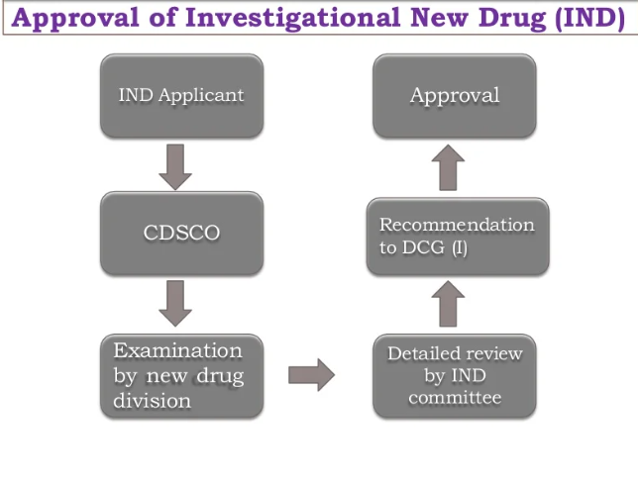

Slide 45
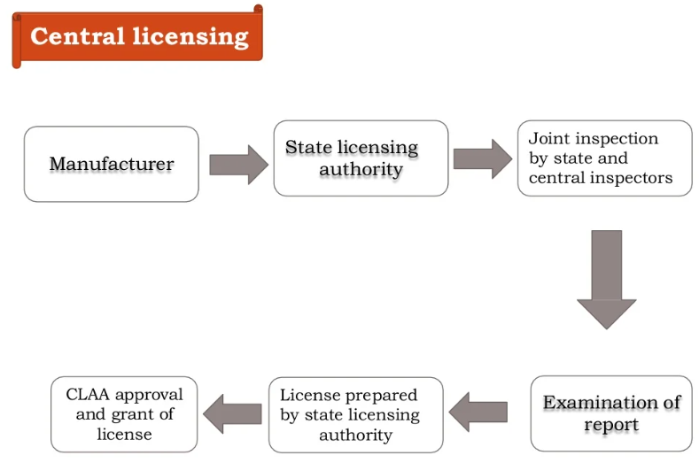

Slide 46
Central Drug Standard Control Organization CDSCO
Head quarters New Delhi
North Zone Ghaziabad
West Zone Mumbai
South Zone Chennai
East Zone Kolkata.
Other zonal offices Ahmedabad and Hyderabad.
Sub-Zonal Office 2
Port offices/Airports 7
Laboratories 6

Slide 47
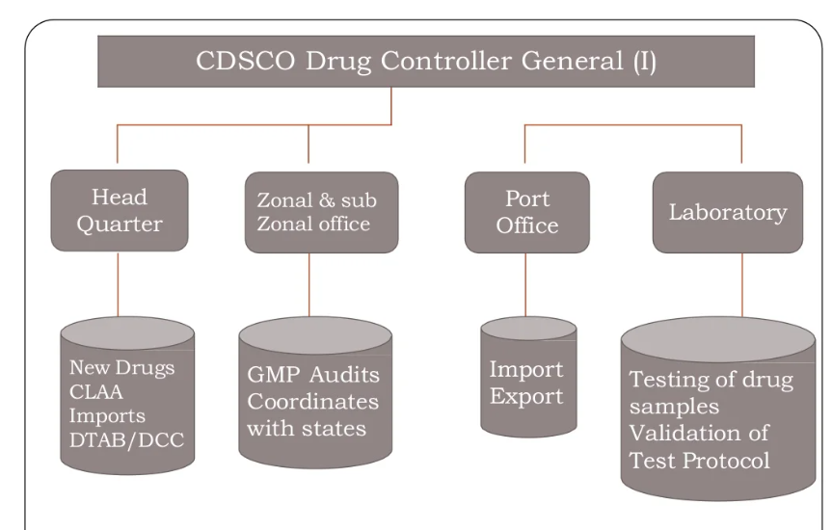

Slide 48
Functions undertaken by Central Government Statutory function:
Laying down standards of drugs, cosmetics, diagnostics and devices.
Laying down regulatory measures, amendments to Acts and rules.
To regulate market authorization of new drugs.
To regulate clinical research in India.
To approve licenses to manufacture certain categories of drugs as Testing of drugs by Central Drugs Labs.
National Institute of Health and Family Welfare
NIHFW is an Apex Technical Institute, funded by Ministry of Health and Family Welfare, for promotion of health and family welfare programmers in the country through education, training, research, evaluation, consultancy and specialized services.

Slide 49
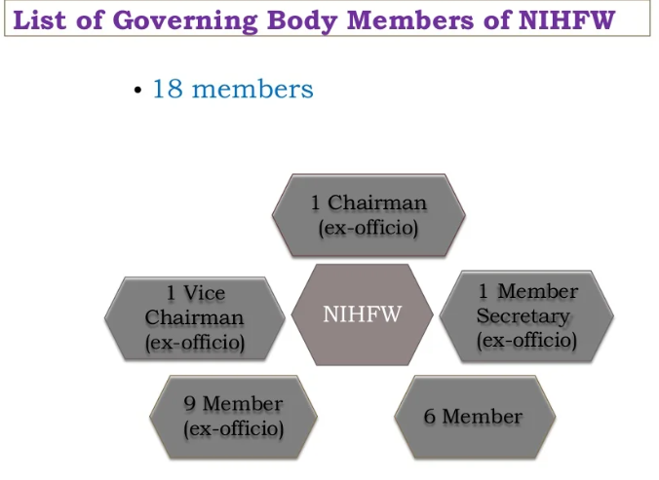

Slide 50
ACTIVITIES AND RESPONSIBILITIES
Measuring weight of children to assess the nutritional status.
Assessment of diseases like level of anemia.
Testing of food material like cooking salt for level iodine.
To release fund on the advice of the Ministry.
It is responsible for all governmental programs relating to family planning in India.

Slide 51
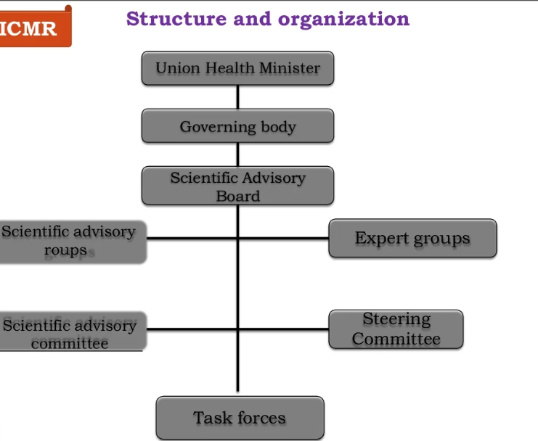

Slide 52
IPA
The Indian Pharmaceutical Association (IPA) has demanded to amend the Drugs &Cosmetics Act and Rules 1945 to make only the pharmacy graduates eligible to become expert staffs in the pharma manufacturing units.
In the resolutions passed during the just concluded IPA Convention, the IPA also urged the government to expedite action to amend the Rules in such way that all regulatory positions in the country must be an exclusive area for experienced and qualified pharmacists.
Indian Pharmaceutical Association (IPA) is the premier professional association of pharmacists in India.

Slide 53
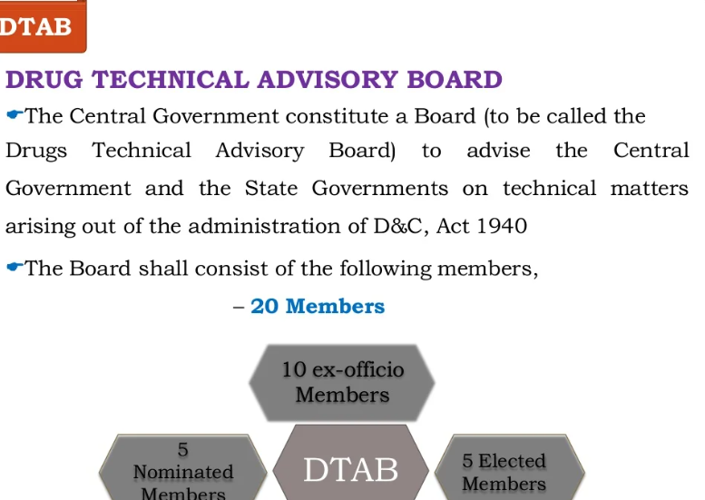

Slide 54
ACTIVITIES AND RESPONSIBILITIES
It advices matter related to Drugs.
The nominated and elected members of the Board shall hold office for three years, but shall be eligible for re-nomination and re-election.
The Board may, subject to the previous approval of the Central Government, regulating its own procedure.

Slide 55
CENTRAL DRUG TESTING LABORATORY
The central drug testing laboratory, Kolkata is national statutory laboratory of the government of India for quality control of drug and cosmetic and established under the D&C act ,1940.
Oldest quality control laboratory of the drug control authorities in India.
Function under the director general of Health Services in the Ministry of Health and Family Welfare.

Slide 56
FUNCTIONS UNDER TAKEN
Statutory Function :
To Act as an Appellate authority.
To function as Government Analyst for such states who do not have their own testing facilities.
Analytical quality control of majority of the imported drugs.
Analytical quality control of drug formulations manufactured within the country on behalf of the Central & State Drug standard control organization
Other Functions:
Procurement, establishment, maintenance, Storage and distribution of I.P & International Reference standards.
Preparation and standardization of I.P. reference standards against USP, BP primary standards.
To undertake analytical research in standardization and methodology development of drug.

Slide 57
Indian Pharmacopoeia Commission (IPC)
General body (19 Members)
CIPL (chemical industry of pharmaceutical laboratories) lab Governing body (10members)
IPC secretariat Scientific body 23 experts
Development of comprehensive monographs
Accord priority to monographs of drugs included in the national Essential Drug List and their dosage forms.
Preparation of monograph for products that have normally been in the market for not less than 2 years.
Collaborate with pharmacopoeias like the BP, USP, JP and International Pharmacopoeia with a view to harmonizing with global standards.

Slide 58
NPPA National Pharmaceutical Pricing Authority
For the purpose of implementing provisions of DPCO, powers of the Government have been vested in the National Pharmaceutical Pricing Authority (NPPA).
Drugs have been declared as essential and accordingly put under the Essential Commodities Act.

Slide 59
GMP Good Manufacturing Practices
GMP guidelines are not prescriptive instructions on how to manufacture products.
They are a series of general principles that must be observed during manufacturing.
When a company is setting up its quality program and manufacturing process, there may be many ways it can fulfill GMP requirements.
It is the company's responsibility to determine the most effective and efficient quality process.
REQUIREMENTS
To ensure that their products are safe, pure, and effective.
To minimize or eliminate contamination, mix up and errors.
Issues including recordkeeping, personnel qualifications, sanitation, cleanliness, equipment verification, process validation, and complaint Handling.
GMP is also sometimes referred to as "cGMP”.
Failure of firms to comply with GMP regulations can result in very serious consequences including recall, fines, and even imprisonment.

Slide 60
WHO GUIDELINES (World Health Organization)
Who is an agency of United Nations.
It is a specialized agency and its primary responsibility includes international health matters so that the goal, health for all, can be achieved.
The WHO, GMP and the certification scheme was accepted by WHA (world health assembly) in solution no WHA 28.65, as the revised version in 1975.
With appearance of ISO (International Organization For Standardization) the WHO GMP needed next revision.
The revised text contains 3 parts.
Part I: out lines the general concepts of quality assurance and salient components of GMP’s.
Part II: outlines on actions to be taken by production & quality control personnel separately for implementing general principles of quality assurance.
Part III: supporting and supplementary guidelines.

Slide 61
The agency of the U.S. Department of Health and Human Services, Established in 1927.
The U.S. Food and drug administration (FDA) is an agency of the United States Department of Health and Human services and is responsible for the safety regulation of
most type of foods like
dietary supplements
Drug
Vaccines
Biological medical products
blood products
medical devices
radiation – emitting devices
veterinary products and Cosmetics.

Slide 62
THANK YOU

